Slide 1




      L.O: To know what puberty is and some internal and external changes that might occur.
  We will be thinking about:
  What puberty is.
  How girl’s and boy’s bodies change during puberty.
  What happens during menstruation (periods).
  What is meant by ejaculation and wet dreams.

Slide 2


Growing and changing.
What’s our starting point?
Draw a person about the same age as you.
Think about the changes that will happen to that person as they become a teenager.
Write the changes around your picture.
Keep this safe for later! We’ll come back to it at the end of the session.

Slide 3
True or false?
Read the statements below and decide if you think they are true or false.
Click on the statement to reveal the correct answer.
True
During puberty the body grows quickly. It is caused by changes in something called hormones. These are chemicals that send messages around the body.
Puberty is when a person’s body changes from being a child to being an adult.
False
Puberty starts at different times between ages 8 and 13 in females, and ages 9 and 15 in males. It starts when the body is ready, a bit like losing your milk teeth.
Puberty starts at the same time for everyone.
Notes:
Puberty is when a person’s body changes from being a child to being an adult. → True During puberty the body grows quickly. It is caused by changes in something called hormones. These are chemicals that send messages around the body.
Puberty starts at the same time for everyone. → False Puberty starts at different times between ages 8 and 13 in females, and ages 9 and 15 in males. It starts when the body is ready, a bit like losing your milk teeth.

Slide 4
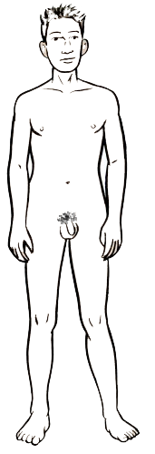
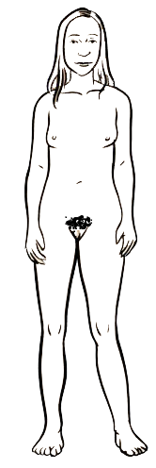
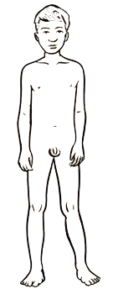
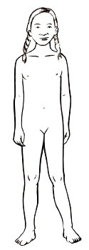
The changing body
PAIR TASK: On you sheet with the male and female bodies:
Label any changes the body might go through as a person gets older.
2) Label the male and female body parts

Slide 5
The changing body
Changes the male and female body may go through as we get older:
Males:
Females:
Muscle increases
Penis and testicles grow
Grow pubic hair
Grow taller
Get spots and sweat more
Get oilier skin and hair
Get a deeper voice
Grow breasts
Hips and waist change shape
Grow pubic hair
Grow taller
Get spots and sweat more
Get oilier skin and hair
Get a deeper voice

Slide 6
Parts of the body
When we talk about parts of the body, we sometimes use special words with our families, everyday slang words or scientific words.
This can make it confusing to figure out if we mean the same thing.
We are going to use scientific words to describe body parts.
How many parts can you name in the pictures below?
nipple
hips
penis
chest
vulva
(internally - vagina)
stomach
legs
testicles
Click each part to reveal the correct names

Slide 7
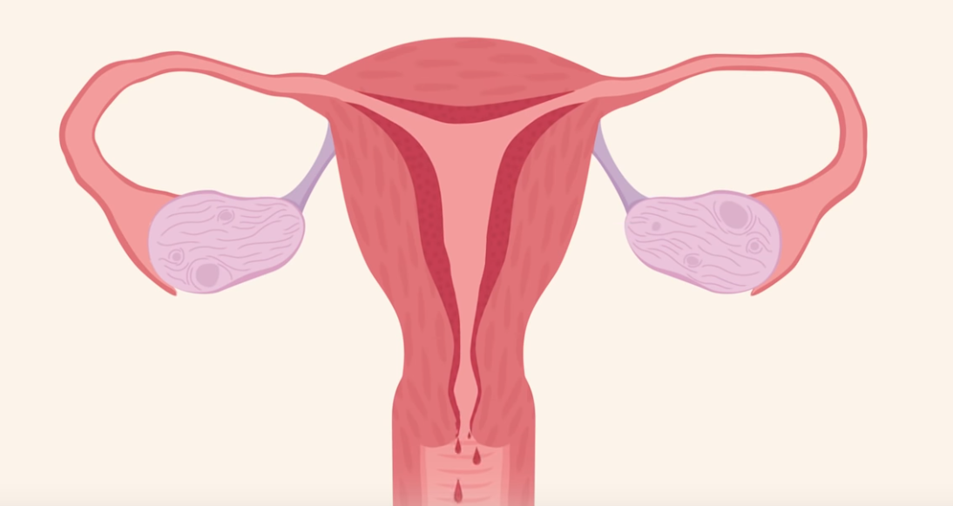
TEACH IN GENDER GROUPS
Alex has overheard their older sister talking to her parents.
Can you pick something up for me from the shop? I’ve started my period.
What changes do you think are happening to Alex’s sister’s body?
Write down your answer, or discuss this with a partner.
Alex’s sister is starting her period, this is a change that happens to females during puberty.
A period is when females pass blood from the vagina for a few days each month.
The scientific name for this is menstruation.
Periods can start at different ages for different people.
Click on this picture to watch a video explaining more →
about periods.
Notes:
Link to video: https://www.youtube.com/watch?v=vXrQ_FhZmos

Slide 8
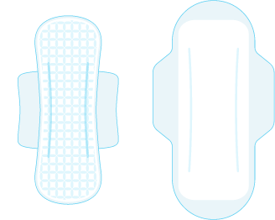
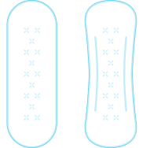

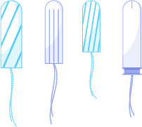

TEACH IN GENDER GROUPS
Clara is in Year 7. Can you think of any products she might use to help manage her periods?
Clara could use a pad.
These come in different shapes and sizes and are worn outside the body. Some are reusable and can be washed. Others are disposable.
Clara could use a tampon.
These come in different shapes and sizes. Sometimes they have applicators, and they are worn inside the vagina. They need to be removed and disposed of regularly.
Clara could use a period pants.
These are absorbent and are worn like normal underwear. They can be washed and reused.

Slide 9
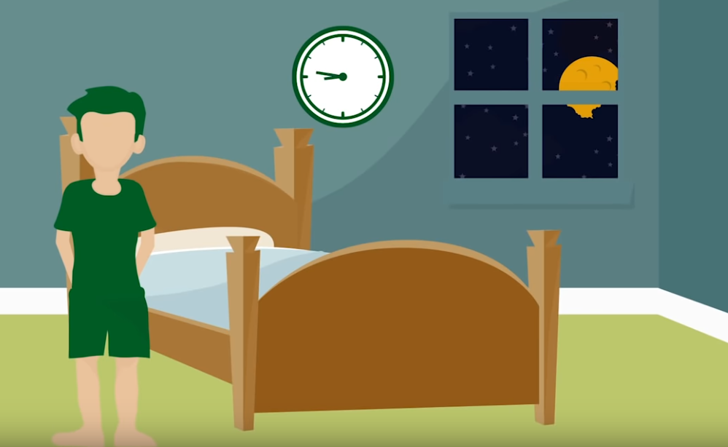
Read Zach’s story below:
TEACH IN GENDER GROUPS
Zach woke up one morning to find that his PJ trousers were sticky and wet. He was confused and a little embarrassed — for a moment he was worried he’d wet himself.
What do you think has happened to Zach?
Write down your answer, or discuss this with a partner.
Zach has had a wet dream.
A wet dream is what happens when the penis becomes erect and ejaculates. This means that semen, which contains sperm cells, has been released from the penis. This is a normal part of puberty for males and is nothing to be embarrassed about.
Click on this picture to watch a video explaining more →
about wet dreams.
Notes:
Link to video: https://www.youtube.com/watch?v=RJtbLfJ_kRk

Slide 10
TEACH IN GENDER GROUPS
What do you think?
Read the questions below and discuss or write down what you think.
Click each statement to reveal the answers.
If a person wants to, they can go swimming on their period. They will need to use a tampon while they swim.
Do periods always hurt?
Can a person go swimming on their period?
Sometimes periods can make a person’s tummy or back hurt. However for some people they don’t cause any aches or pains.
Wet dreams are a normal part of growing up but some people may not experience them.
When a person grows body hair during puberty, they may choose to remove it, but this is a choice for each person to make.
Do all boys have wet dreams?
Does a person who is going through puberty have to shave?
Notes:
Can a person go swimming on their period?
If a person wants to, they can go swimming on their period. They will need to use a tampon or menstrual cup to while they swim.
Do periods always hurt?
Sometimes periods can make a person’s tummy or back hurt. However for some people they don’t cause any aches or pains.
Do all boys have wet dreams?
Wet dreams are a normal part of growing up but some people may not experience them.
Does a person who is going through puberty have to shave?
When a person grows body hair during puberty, they may choose to remove it, but this is a choice for each person to make.

Slide 11

Growing and changing.
Where are you now?
Look back at your picture of a person about your age from when we began learning about puberty in this session.
Can you add to or change anything that you have written around the person, about the changes that might happen to them as they grow up?

Slide 12

Remember!
If you feel worried about puberty or what you have learned during this session, talking to an adult you trust is one of the best ways to find help.
If you want to talk to someone other than a parent:
ChildLine can help.
See: https://www.childline.org.uk/get-support/
Or phone 0800 1111
Talk to a trusted adult at home
ChildLine: www.childline.org.uk
0800 1111

